Slide 1
The Hadoop Ecosystem
By
Pragya Singhvi

Slide 2
Overview
Big Data Challenges
Distributed system and challenges
Hadoop Introduction
History
Who uses Hadoop
The Hadoop Ecosystem
Hadoop core components
HDFS
Map Reduce
Other Hadoop ecosystem components
Hbase
Hive
Pig
Impala
Sqoop
Flume
Hue
Zookeeper
Demo

Slide 3
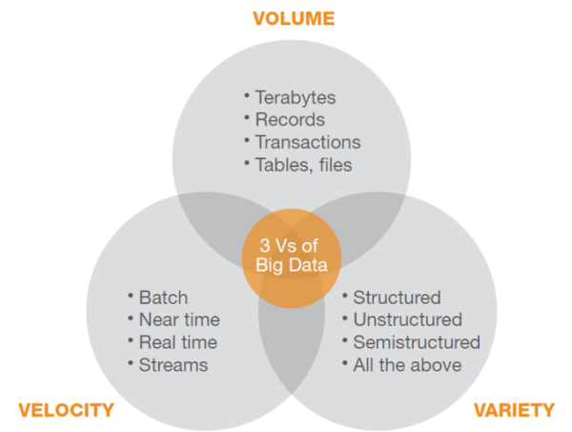
Big Data Challenges
Notes:
Reference for diagram: http://blog.vitria.com/bid/87945/Big-Data-Analytics-Challenges-Facing-All-Communications-Service-Providers

Slide 4
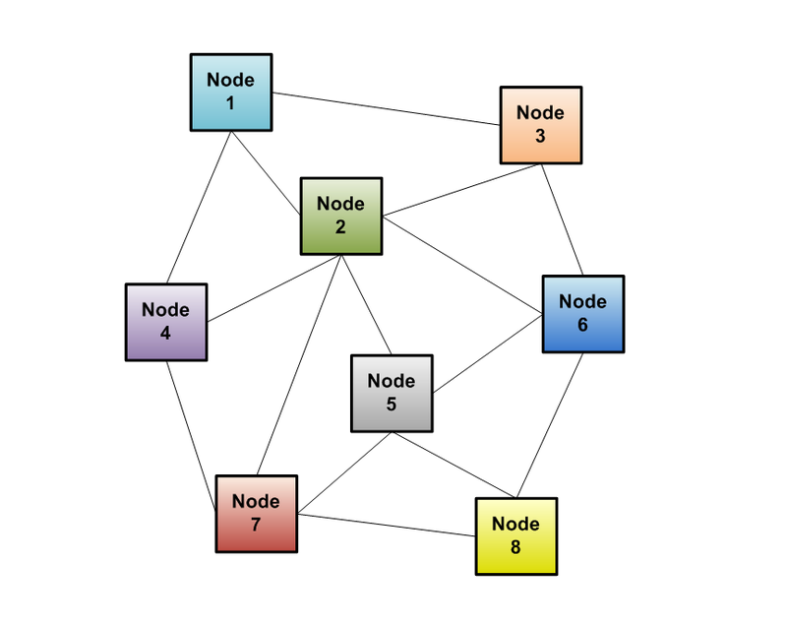
Solution: Distributed system

Slide 5
Distributed System Challenges
Programming Complexity
Finite bandwidth
Partial failure
The data bottleneck

Slide 6
New Approach to distributed computing
Hadoop:
A scalable fault-tolerant distributed system for data storage and processing
Distribute data when the data is stored
Process data where the data is
Data is replicated

Slide 7
Hadoop Introduction
Apache Hadoop is an open-source software framework for storage and large-scale processing of data-sets on clusters of commodity hardware.
Some of the characteristics:
Open source
Distributed processing
Distributed storage
Scalable
Reliable
Fault-tolerant
Economical
Flexible
Notes:
Definition by wikipidia: http://en.wikipedia.org/wiki/Apache_Hadoop

Slide 8

History
Originally built as a Infrastructure for the “Nutch” project.
Based on Google’s map reduce and google File System.
Created by Doug Cutting in 2005 at Yahoo
Named after his son’s toy yellow elephant.

Slide 9
Who uses Hadoop
http://wiki.apache.org/hadoop/PoweredBy
http://wiki.apache.org/hadoop/Distributions%20and%20Commercial%20Support

Slide 10
The Hadoop Ecosystem
http://hadoopecosystemtable.github.io/

Slide 11
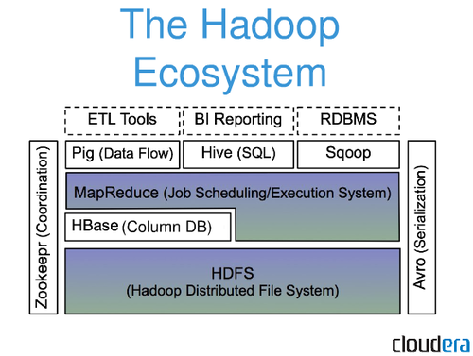

Slide 12
Hadoop Core Components
HDFS – Hadoop Distributed File System (Storage)
Map Reduce (Processing)

Slide 13
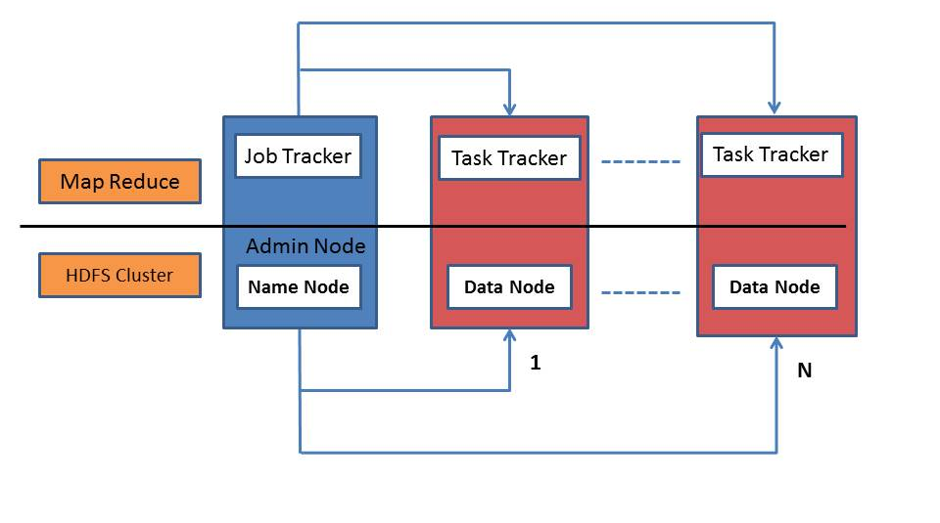
Hadoop Core Components

Slide 14
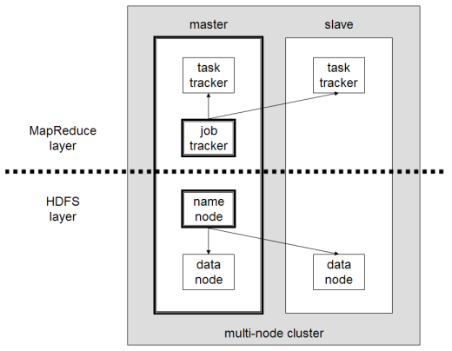
A multi-node Hadoop cluster
Notes:
Reference: http://en.wikipedia.org/wiki/Apache_Hadoop

Slide 15
Nodes
NameNode:
Master of the system
Maintains and manages the blocks which are present on the DataNodes
DataNodes:
Slaves which are deployed on each machine and provide the actual storage
Responsible for serving read and write requests for the clients
Jobtracker:
takes care of all the job scheduling and assign tasks to Task Trackers.
TaskTracker:
a node in the cluster that accepts tasks - Map, Reduce and Shuffle operations - from a jobtracker

Slide 16
HDFS
Hadoop Distributed File System (HDFS) is designed to reliably store very large files across machines in a large cluster. It is inspired by the GoogleFileSystem.
Distribute large data file into blocks
Blocks are managed by different nodes in the cluster
Each block is replicated on multiple nodes
Name node stored metadata information about files and blocks
Notes:
Definition by http://wiki.apache.org/hadoop/HDFS

Slide 17
Map Reduce
The Mapper:
Each block is processed in isolation by a map task called mapper
Map task runs on the node where the block is stored
The Reducer:
Consolidate result from different mappers
Produce final output

Slide 18
What makes Hadoop unique
Moving computation to data, instead of moving data to computation.
Simplified programming model: allows user to quickly write and test
Automatic distribution of data and work across machines

Slide 19
Other Hadoop components in Ecosystem
HBase | Hadoop database for random read/write access
Hive | SQL-like queries and tables on large datasets
Pig | Data flow language and compiler
Oozie | Workflow for interdependent Hadoop jobs
Sqoop | Integration of databases and data warehouses with Hadoop
Flume | Configurable streaming data collection
ZooKeeper | Coordination service for distributed applications
Notes:
(Refer “Sources and References point 10” in article http://practicalanalytics.wordpress.com/2011/11/06/explaining-hadoop-to-management-whats-the-big-data-deal/ )

Slide 20
Hbase
HBase is an open source, non-relational, distributed database modeled after Google's BigTable.
It runs on top of Hadoop and HDFS, providing BigTable-like capabilities for Hadoop.

Slide 21
Features of Hbase
Type of NoSql database
Strongly consistent read and write
Automatic sharding
Automatic RegionServer failover
Hadoop/HDFS Integration
HBase supports massively parallelized processing via MapReduce for using HBase as both source and sink.
HBase supports an easy to use Java API for programmatic access.
HBase also supports Thrift and REST for non-Java front-ends.

Slide 22
Hbase in CAP theorem
Eric Brewer’s CAP theorem, HBase is a CP type system.
Notes:
Consistency, Availability, Partition tolerance

Slide 23
When to use Hbase
When there is real big data: millions or billions of rows, in other way data can not store in a single node.
When random read/write access to big data
When require to do thousands of operations on big data
When there is no need of extra features of RDMS like typed columns, secondary indexes, transactions, advanced query languages, etc.
When there is enough hardware.

Slide 24
Difference between Hbase and HDFS
HDFS | Hbase
Good for storing large file | Built on top of HDFS. Good for hosting very large tables like billions of rows X millions of column
Write once. Append to files in some of recent versions but not commonly used | Read/write many
No random read/write | Random read/write
No individual record lookup rather read all data | Fast records lookup(update)

Slide 25
Hive
An sql like interface to Hadoop.
Data warehouse infrastructure built on top of Hadoop
Provide data summarization, query and analysis
Query execution via MapReduce
Hive interpreter convert the query to Map reduce format.
Open source project.
Developed by Facebook
Also used by Netflix, Cnet, Digg, eHarmony etc.

Slide 26
Hive
HiveQL example:
SELECT customerId, max(total_cost) from hive_purchases GROUP BY customerId HAVING count(*) > 3;

Slide 27
Pig
A scripting platform for processing and analyzing large data sets
Apache Pig allows to write complex MapReduce programs using a simple scripting language.
High level language: Pig Latin
Pig Latin is data flow language.
Pig translate Pig Latin script into MapReduce to execute within Hadoop.
Open source project
Developed by Yahoo

Slide 28
Pig
Pig Latin example:
A = LOAD 'student' USING PigStorage() AS (name:chararray, age:int, gpa:float);
X = FOREACH A GENERATE name,$2;
DUMP X;

Slide 29
Pig and Hive
Both requires compiler to generate Map reduce jobs
Hence high latency queries when used for real time responses to ad-hoc queries
Both are good for batch processing and ETL jobs
Fault tolerant
Notes:
Extract, Transform, Load

Slide 30
Impala
Cloudera Impala is a query engine that runs on Apache Hadoop.
Similar to HiveQL.
Does not use Map reduce
Optimized for low latency queries
Open source apache project
Developed by Cloudera
Much faster than Hive or pig

Slide 31
Comparing Pig, Hive and Impala
Description of Feature | Pig | Hive | Impala
SQL based query language | No | yes | yes
Schema | optional | required | required
Process data with external scripts | yes | yes | no
Extensible file format support | yes | yes | no
Query speed | slow | slow | fast
Accessible via ODBC/JDBC | no | yes | yes
Notes:
(Refer cloudera training material chapter 5 “Comparing Pig,Hive, and Impala” page 5-28
url: http://training.cloudera.com/essentials.pdf )

Slide 32
Sqoop
Command-line interface for transforming data between relational database and Hadoop
Support incremental imports
Imports use to populate tables in Hadoop
Exports use to put data from Hadoop into relational database such as SQL server
Hadoop
RDBMS
sqoop

Slide 33
How Sqoop works
The dataset being transferred is broken into small blocks.
Map only job is launched.
Individual mapper is responsible for transferring a block of the dataset.

Slide 34
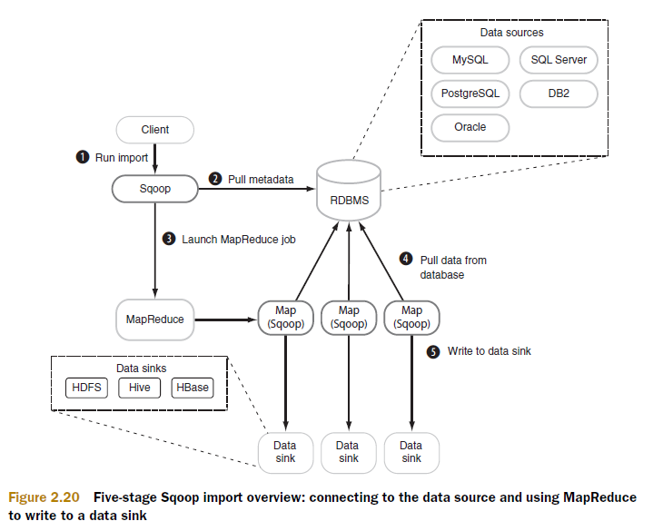
How Sqoop works
Notes:
http://ramionweb.blogspot.com/2013/04/moving-data-into-hadoop.html

Slide 35
Flume
Apache Flume is a distributed, reliable, and available service for efficiently collecting, aggregating, and moving large amounts of streaming data into the Hadoop Distributed File System (HDFS).
Notes:
Reference: http://hortonworks.com/hadoop/flume/

Slide 36
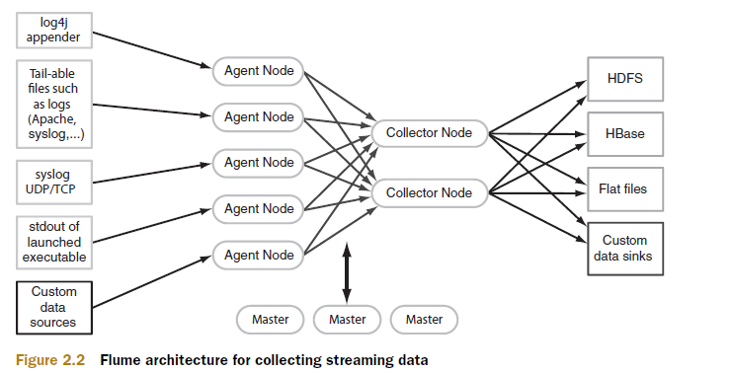
How flume works
Notes:
http://ramionweb.blogspot.com/2013/04/moving-data-into-hadoop.html

Slide 37
How flume works
Data flows like:
Agent tier -> Collector tier -> Storage tier
Agent nodes are typically installed on the machines that generate the logs and are data’s initial point of contact with Flume. They forward data to the next tier of collector nodes, which aggregate the separate data flows and forward them to the final storage tier.

Slide 38
Hue
Graphical front end to the cluster.
Open source web interface.
Makes Hadoop platform (HDFS, Map reduce, oozie, Hive, etc.) easy to use

Slide 39
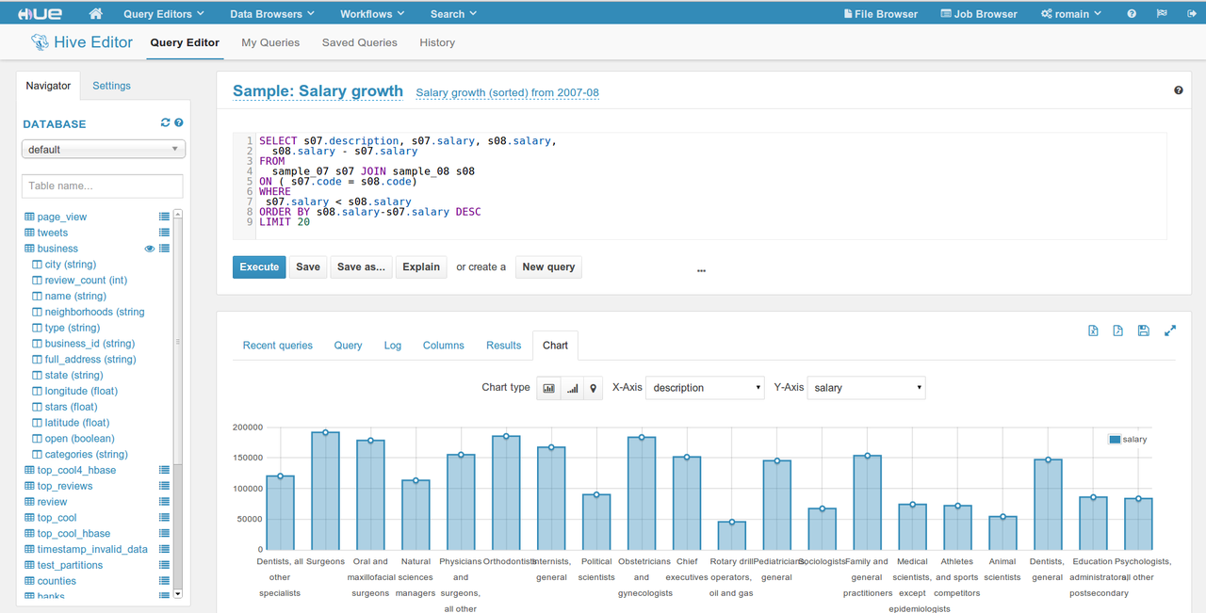
Hue

Slide 40
Zookeeper
Because coordinating distributed systems is a Zoo.
ZooKeeper is a centralized service for maintaining configuration information, naming, providing distributed synchronization, and providing group services.
Notes:
Reference: https://wiki.apache.org/hadoop/ZooKeeper

Slide 41
DEMO

Slide 42
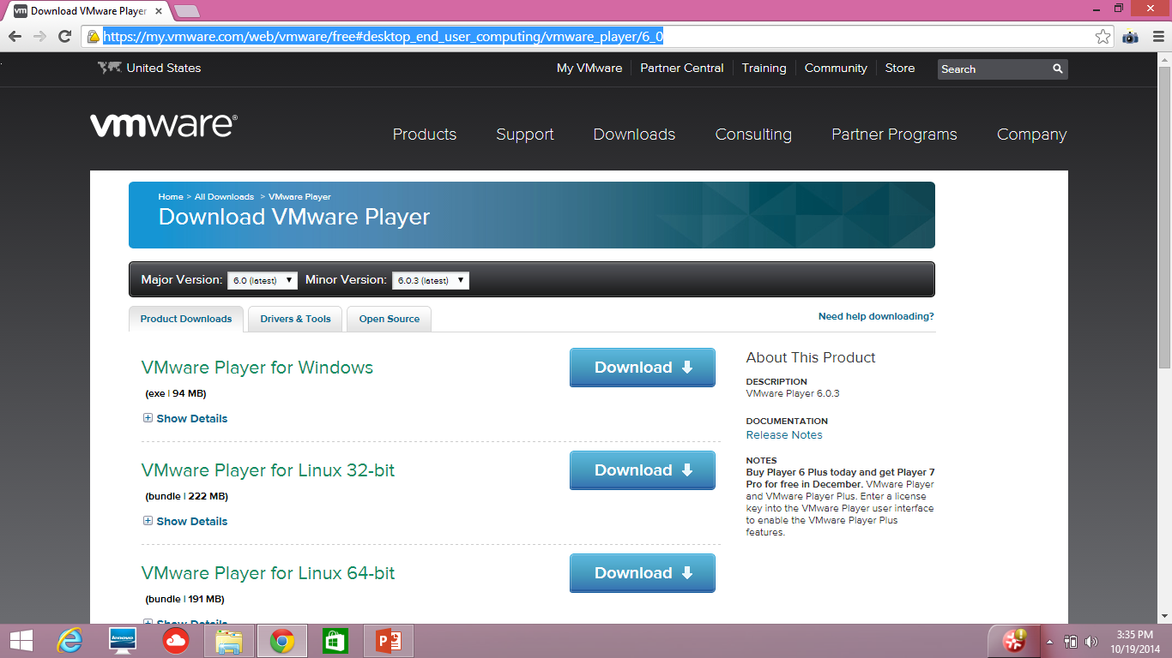
Hadoop Installation (CDH ) for windows
Download and install VM player
https://my.vmware.com/web/vmware/free#desktop_end_user_computing/vmware_player/6_0

Slide 43
Hadoop Installation (CDH ) for windows
Make sure you have enabled virtualization in bios

Slide 44
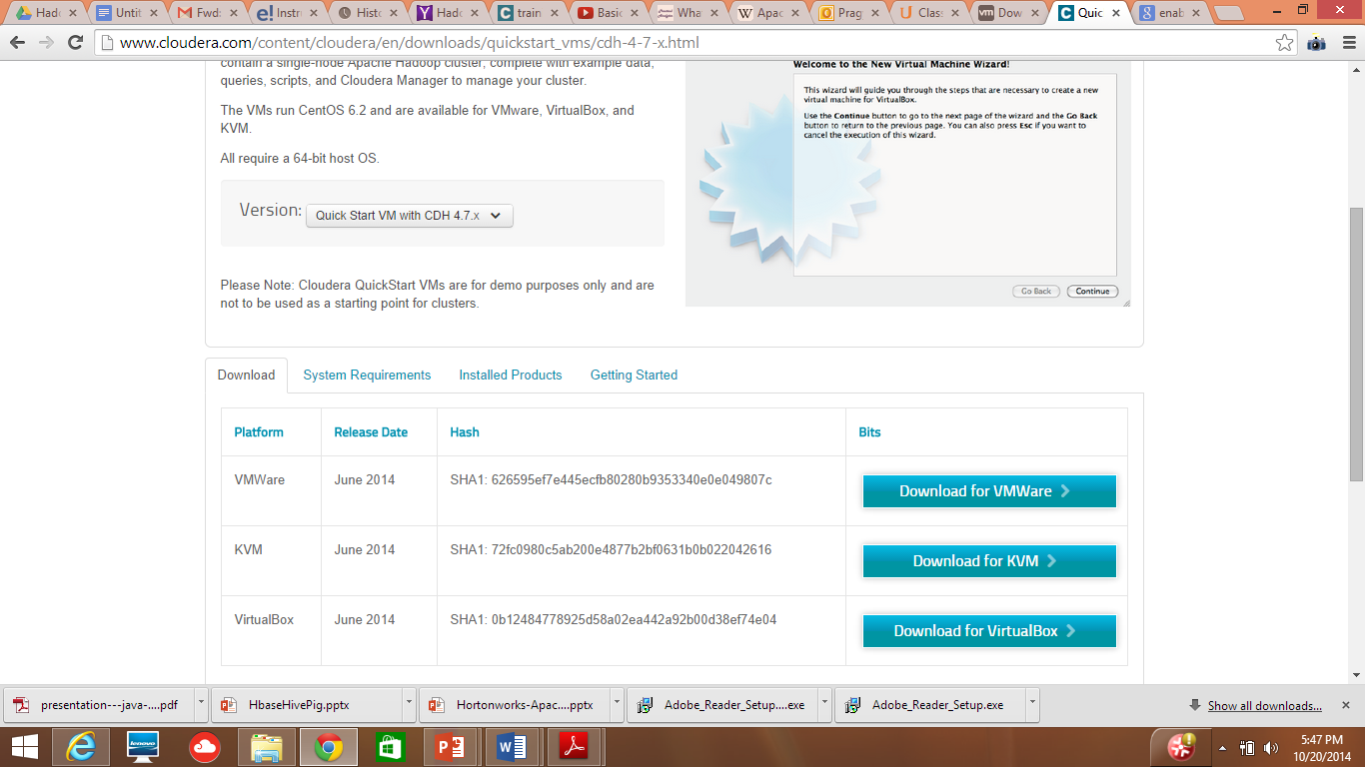
Hadoop Installation (CDH ) for windows
Download “Quick start VM with CDH” : Download for VMWare
http://www.cloudera.com/content/cloudera/en/downloads/quickstart_vms/cdh-4-7-x.html

Slide 45
Hadoop Installation (CDH ) for windows
Unzip “cloudera-quickstart-vm-4.7.0-0-vmware”
Open CDH using VMPlayer:
Open VM Player
Click open a virtual machine
Select the file “cloudera-quickstart-vm-4.7.0-0-vmware” in the extracted directory of “cloudera-quickstart-vm-4.7.0-0-vmware”. Virtual machine will be added to your VM player.
Select this virtual machine and click play virtual machine.

Slide 46
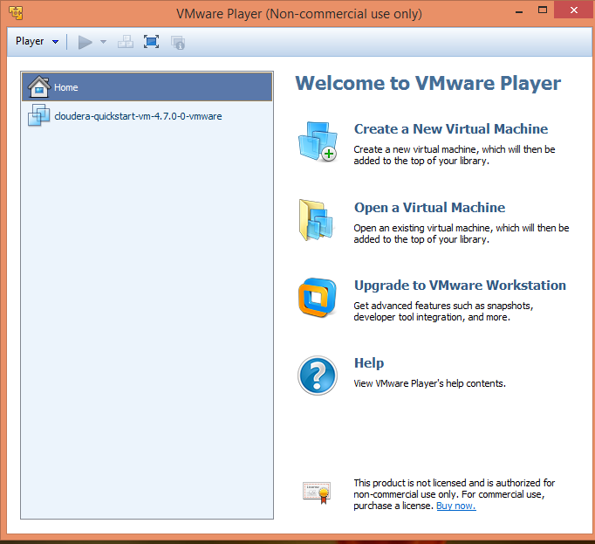

Slide 47
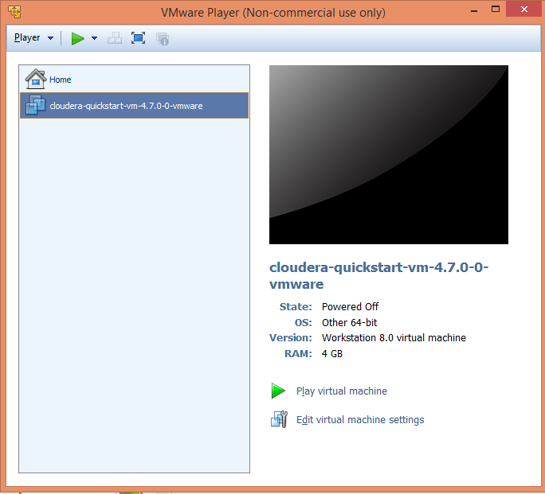

Slide 48
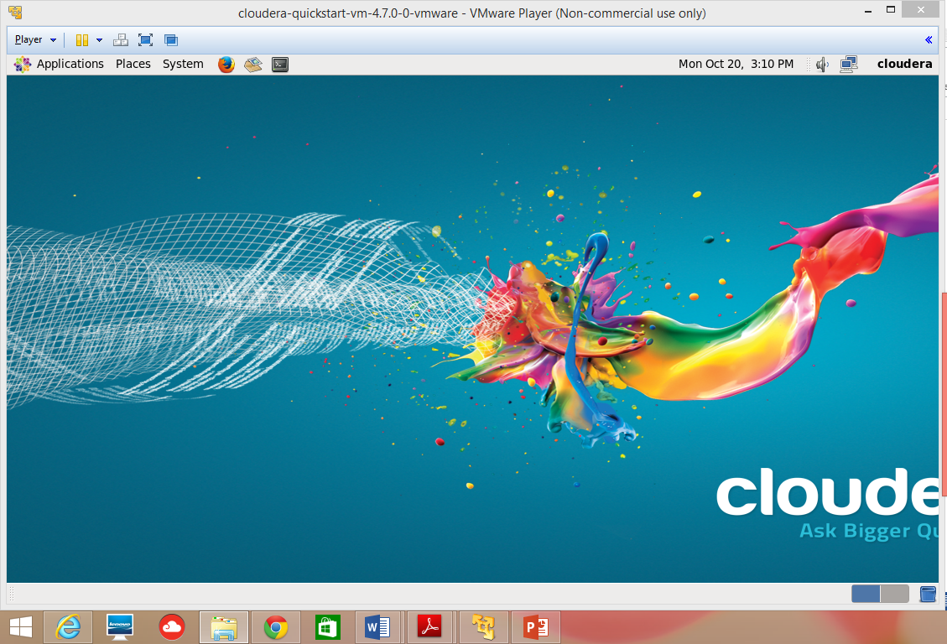

Slide 49
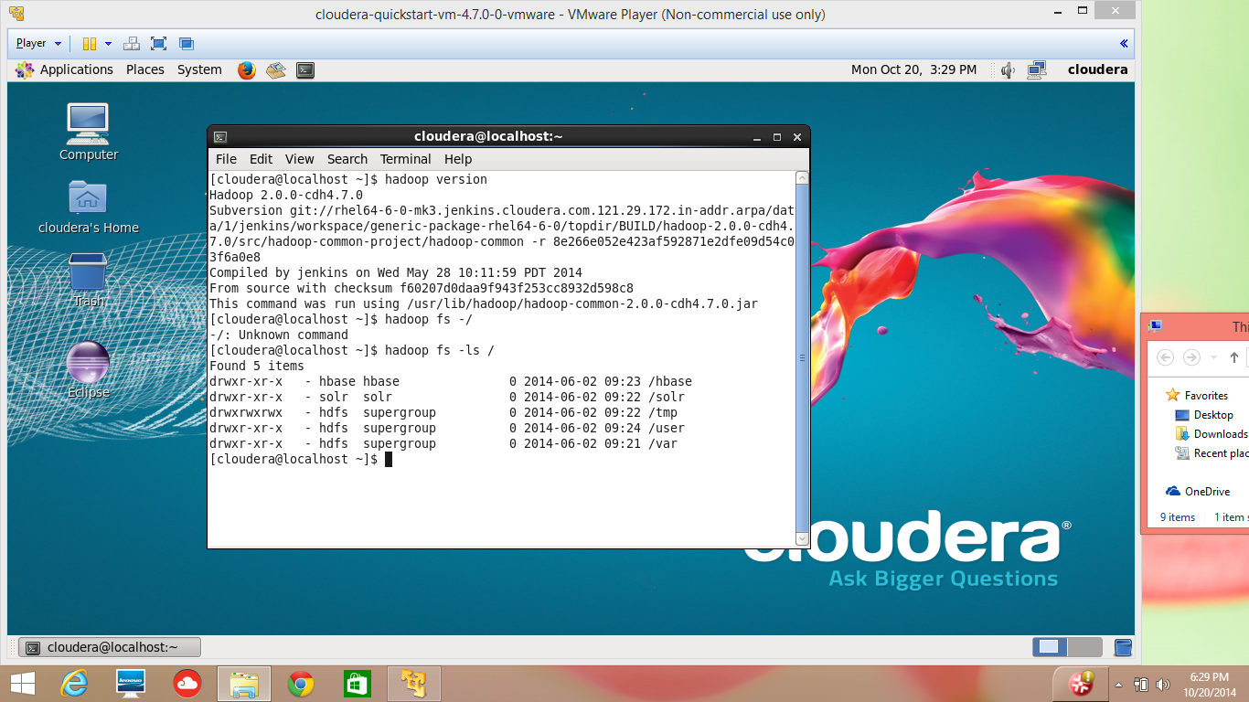

Slide 50
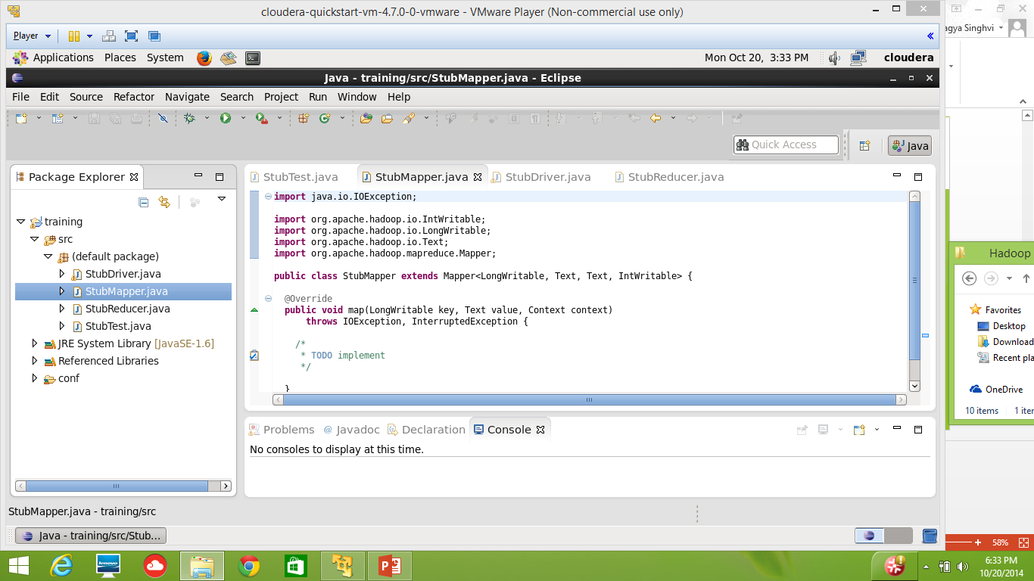

Slide 51
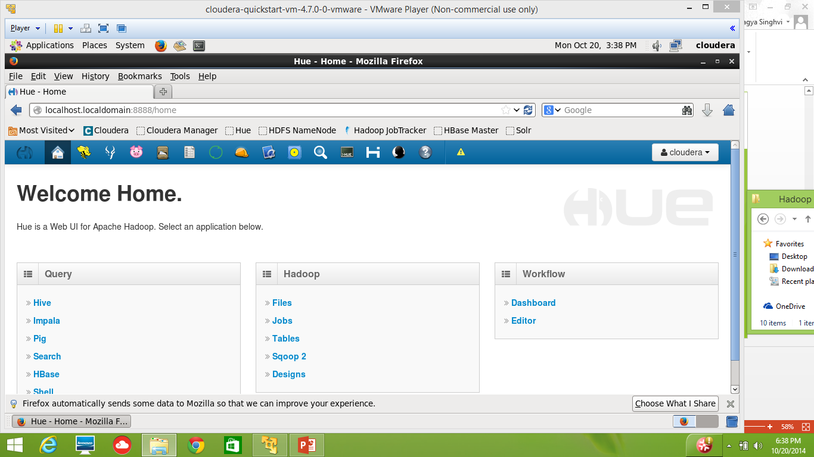

Slide 52
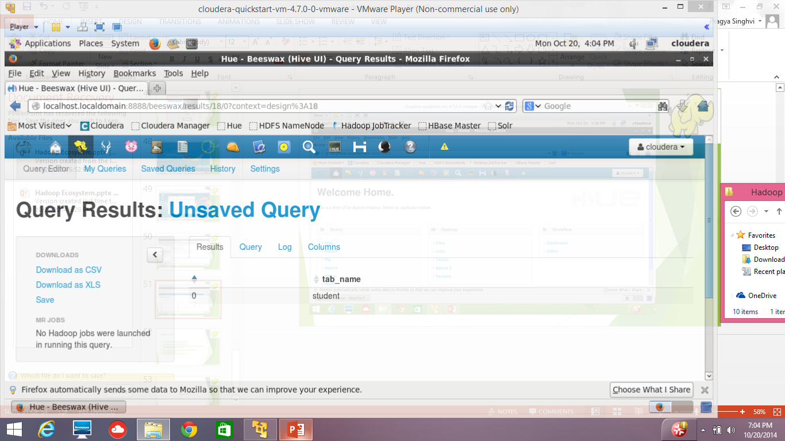

Slide 53
References
http://training.cloudera.com/essentials.pdf
http://en.wikipedia.org/wiki/Apache_Hadoop
http://practicalanalytics.wordpress.com/2011/11/06/explaining-hadoop-to-management-whats-the-big-data-deal/
https://developer.yahoo.com/hadoop/tutorial/module1.html
http://hadoop.apache.org/
http://wiki.apache.org/hadoop/FrontPage

Slide 54
Questions?

Slide 55
Thanks

